Slide 1
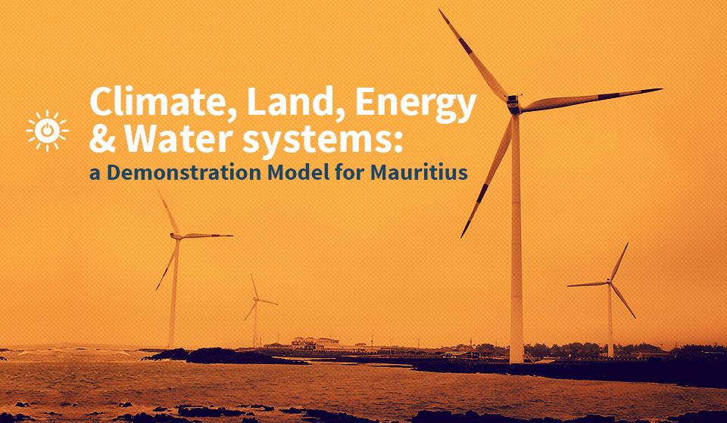

Slide 2
CLEWS Country Module
1. The food-energy-water nexus and sustainable development
2. The need for integrated planning: case studies
3. The CLEWS modelling approach
4. CLEWS case studies
5. Hands-on exercises with CLEWS

Slide 3
4. CLEWS case studies

Slide 4
Applicability
The model architecture has been designed to serve planners and decision makers in developing countries.
Once properly calibrated, a national or regional CLEWS model calculates the resource and service requirements to meet socioeconomic goals—such as national SDG priorities—in a growing economy.
It allows simulations of interactions within the CLEWS system to meet energy, water and food-related service demands.
Constraints imposed by the physical and economic environments are taken into consideration, for instance:
Arable land availability and agricultural production
Energy resources (renewable and exhaustible) within the country
Freshwater availability
Environmental constraints
Access to capital
Energy and/or food security

Slide 5
Possible CLEWS utilization
The model architecture has been designed to serve planners and decision makers in developing countries.
Decision-making: Assist decision and policymakers in assessing options in terms of their likely impacts on the broad CLEWS system and transparently evaluate the trade-offs associated with different options.
Policy assessments: Ensure that policies are as cost-effective as possible. If multiple objectives can be achieved by a comprehensive policy, it may advance development more effectively than policies focused separately on single objectives.
Facilitating policy harmonization and integration: A CLEWS tool would help identify potentially conflicting policies, for example, electricity subsidies that accelerate aquifer depletion, which in turns leads to greater electricity use and subsidy requirements.
Technology assessments: Some technology options can affect multiple resources, e.g., a rapid expansion and deployment of solar and wind-based electricity generation instead of fossil fuel generation could reduce greenhouse gas emissions, local pollution and cooling water requirements; improve energy security; and reduce exposure to volatile fossil fuel markets. A CLEWS tool should allow a more inclusive assessment of technological options.
Scenario development: The elaboration of consistent scenarios of possible socioeconomic development trajectories can help in identifying future development opportunities as well as understanding the implications of different policies.

Slide 6
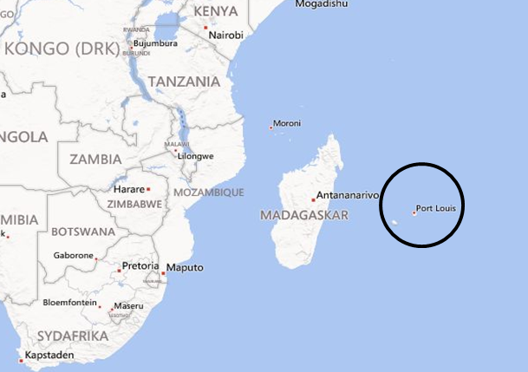
Mauritius
Main revenue from tourism and sugar exports
Expiration of European Union agreement and collapse of sugar revenue
Diversification away from sugarcane to food crops and vegetables
Sugarcane production and refining has been a staple industry
Bagasse from refining provides cogeneration of heat and electricity
Reduction in sugar production led to lower electricity generation from bagasse
A consequent increase in fuel imports coincided with an increase in international fuel prices
Drainage of export revenues and higher carbon emissions
Irrigation requirements higher for food crops than for sugarcane
Increased water demand

Slide 7



Sugarcane to sugar and ethanol
Juice
Bagasse residue
Processing
Ethanol production
Juice is converted sugar and/or ethanol
Storage
Bagasse
Coal
Fermentation
Distillation & Dehydration
Truck loading
Steam & electricity generation (CHP)
Sugar production
Juice treatment & filtering
Evaporation
Steam & electricity for process energy
Electricity sales to the grid
Cooking & crystallization
Centrifuging & drying
Bagging
Source: Adapted from BP.

Slide 8
Policy response
Aim: introduce policies that would utilize domestic sources and substitute energy imports while alleviating water stress
A fuel standard mandating the blending of ethanol (second generation) into gasoline
Improve income prospects for sugar growers at lower water use, displace imported liquid fuels and improve self-sufficiency in fuel supply (energy security)
Mandate a 35% share of renewable electricity generation in the national electricity mix by 2025
Reduction of energy dependency on imported fuel oil and coal, curb carbon emissions
CLEWS analysis—assess economic and environmental benefits of suggested policies

Slide 9
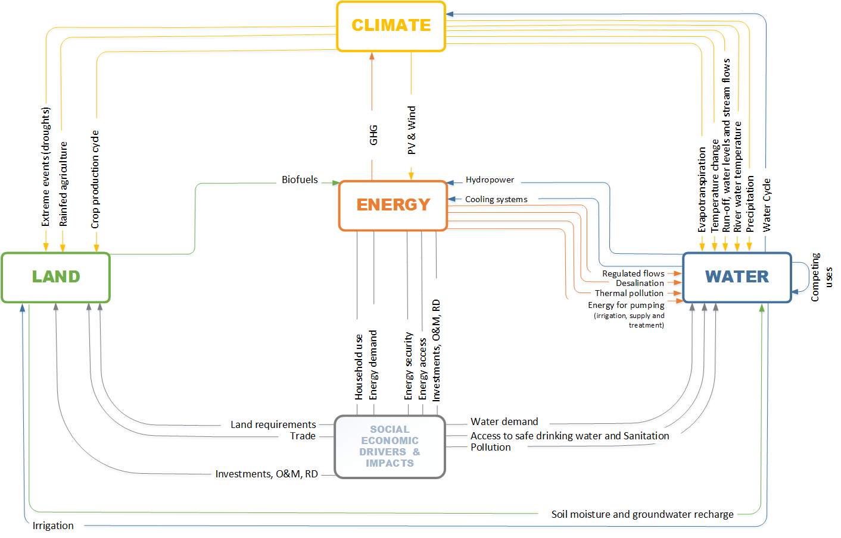
Interlinkages in Mauritius

Slide 10
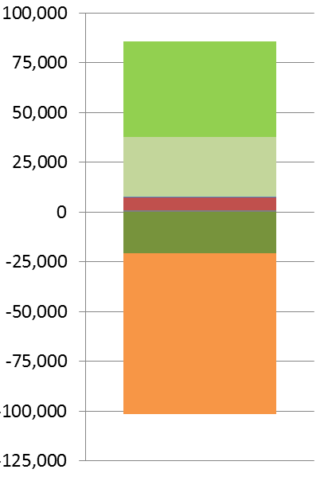
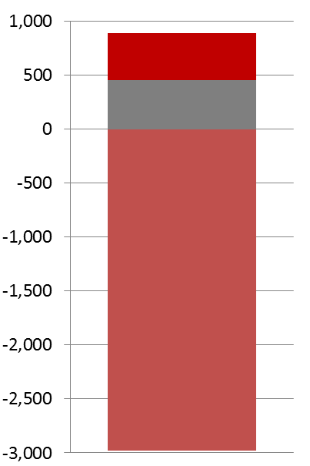
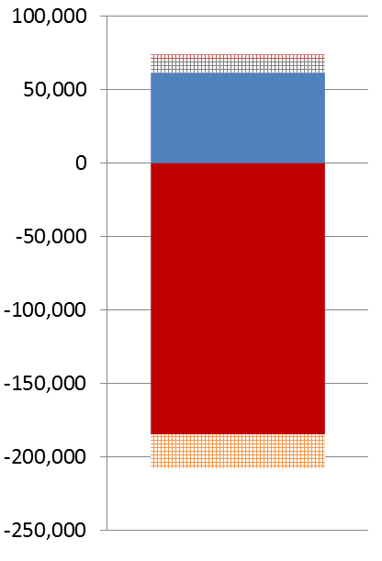
Impact of shifting two major sugar refineries to produce second generation ethanol
Figure 2: THE IMPACT OF TRANSFORMING TWO SUGAR PROCESSING PLANTS TO PRODUCE 2nd GENERATION ETHANOL (PROJECTED FOR 2020)
Reduced fuel imports | Reduced greenhouse gas emissions | Reduced expenditures
Import dependence decreases. Gasoline imports are reduced as ethanol partly replaces gasoline use in the transport fleet. Some of the bagasse is now used for ethanol production instead of electricity generation. This needs to be compensated for by increases in coal and oil product imports. | An overall reduction of greenhouse gas emissions occurs. Emissions are reduced in the transport sector and through reduced gasoline refining as gasoline is replaced by ethanol. The increased use of coal and oil (instead of bagasse) for electricity generation results in additional emissions. | Ethanol production is economically beneficial. As some of the sugar is converted to ethanol, there are reduced expenditures for sugar refining and gasoline imports. This outweighs the costs associated with the ethanol production, the increases in oil and coal imports and the reduced sugar export earnings.
Oil & coal prod.
Reduction of sugar exports
Oil
Electricity generation
Ethanol prod.
Baseline
Coal
Oil imports
Sugar prod.
[1000 GJ]
[ton CO₂eq]
Transportation
[1000 US$ - Real 2005]
Gasoline imports
Gasoline
Gasoline refining

Slide 11
Impact of shifting two major sugar refineries to produce second-generation ethanol
Figure 2: THE IMPACT OF TRANSFORMING TWO SUGAR PROCESSING PLANTS TO PRODUCE 2nd GENERATION ETHANOL (PROJECTED FOR 2020)
Reduced fuel imports | Reduced greenhouse gas emissions | Reduced expenditures
Import dependence decreases. Gasoline imports are reduced as ethanol partly replaces gasoline use in the transport fleet. Some of the bagasse is now used for ethanol production instead of electricity generation. This needs to be compensated for by increases in coal and oil product imports. | An overall reduction of greenhouse gas emissions occurs. Emissions are reduced in the transport sector and through reduced gasoline refining as gasoline is replaced by ethanol. The increased use of coal and oil (instead of bagasse) for electricity generation results in additional emissions. | Ethanol production is economically beneficial. As some of the sugar is converted to ethanol, there are reduced expenditures for sugar refining and gasoline imports. This outweighs the costs associated with the ethanol production, the increases in oil and coal imports, and reduced sugar export earnings.
Oil & coal prod.
Reduction of sugar exports
Oil
Electricity generation
Ethanol prod.
Baseline
Coal
Oil imports
Sugar prod.
[1000 GJ]
[ton CO₂eq]
Transportation
[1000 US$ - Real 2005]
Gasoline imports
Gasoline
Gasoline refining

Slide 12
Overall water withdrawals in different integrated CLEWS scenarios
Water withdrawals under climate change scenarios:
Water withdrawals for domestic purposes and especially irrigation increase strongly under projected climate change scenarios.
To compensate for reduced precipitation, irrigation has to be expanded to previously rain-fed sugar plantations and farms, resulting in higher withdrawals of surface and groundwater
This affects future land-use options (towards less water-intensive crops) and increases energy demand for pumping and desalination
Reference scenario
1st generation methanol production under a “moderate” climate change scenario
2nd generation methanol production under a “moderate” climate change scenario
2nd generation methanol production under a “worst” climate change scenario

Slide 13
Overall electricity demand in different CLEWS scenarios
Increasing electricity demand for different biofuel production technologies:
Energy demand increases in potential climate change scenarios—the amount depends on the water intensity of production options.
While first-generation ethanol production is more effective in the beginning, its overall energy balance turns unfavourable against second-generation ethanol production in the case of reduced water availability.
Reference scenario
1st generation methanol production
1st generation methanol production under a “worst case” climate change scenario
2nd generation methanol production under a “worst case” climate change scenario

Slide 14
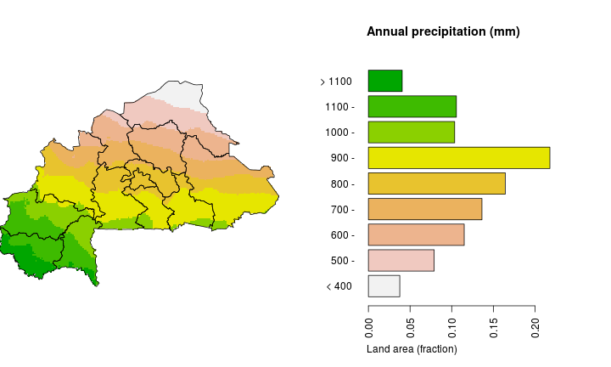
Burkina Faso
Aim: to quantitatively demonstrate the added value of an integrated CLEWS assessment
How: by deriving conclusions from an agricultural model (“current practice approach”) with those of an integrated CLEWS approach
Where: Burkina Faso
Why: | Energy, food and water security
Climate: | Low contribution to emissions but high vulnerability
Land use: | Growing food demand through increasing population
 | Dependence on one main export crop (cotton)
 | Continuous deforestation (loss of carbon sink and fuel source)
Energy: | No domestic fossil fuel resources
 | High fuel import costs (due to landlocked situation)
 | Dependence on wood for energy source
 | Low electrification rates
Water: | Extremely dry areas of the country
 | Strong variability of rainfall (flooding and droughts)
 | Low use of water for irrigation in agriculture
Notes:
See: http://gfc.ucdavis.edu/profiles/rst/bfa.html.

Slide 15
Identified CLEWS interdependencies in Burkina Faso
Climate change effects
Energy options
Land use options
Water options
Conventional fossil fuel power plants
Intensifying agriculture
More dam projects
Importing fuel, electricity and fertilizer
More irrigation/ different crops
Smart irrigation technologies
Production of local biofuels
Use of marginal lands
Groundwater pumping
Use of renewables (small-scale PV, wind, concentrated solar)

Slide 16
Developing a CLEWS model for Burkina Faso
Priority A: food security and agricultural production
Quantifiable Interlinkages
Increase yields of food crops to maintain food security for a growing population
Increase yields of cash crops for export
Production of local biofuels for energy production
Agricultural production
Fertilizer (tons/hectare)
Mechanization of agriculture
Biofuels production
Irrigation water
Priority B: increasing access to water
Increased water access for rural and urban populations
More irrigated areas for agriculture
Water production
Climate and climate change influence
Water pumping/diversion
Priority C: increasing access to modern forms of energy
Decreasing the use of wood as a fuel source in households and industry
Increasing electrification rates (access)
Increase the per capita energy availability
Use of local energy sources
Energy service provision
Water for hydropower PP
Local (bio-) fuel production
Fossil fuel and electricity imports
Fertilizer imports

Slide 17
Projected CLEWS-relevant developments - Population -
Burkina Faso currently has a population growth rate of 3% per year, increasing stress on all CLEWS resources. According to official United Nations projections, the population will continue to grow and might reach the 20 million mark in 2017 or 2018. Intensifying urbanization will impact land use, water and energy balances.

Slide 18
Projected CLEWS-relevant developments - Electricity demand -
Projected electricity production and imports to 2015. It is expected that electricity imports will be around 70% by 2015, while local production is reduced.
Governmental plans for electrification: By 2020 67% of the population shall have access to electricity (100% in urban areas, 49% in rural areas).

Slide 19
Projected CLEWS-relevant developments - Water -
The water sector is extremely vulnerable to climate change with strongly varying precipitation. Future population growth predominantly in urban areas as well as increased irrigation areas as planned by the Government (right graph) will put increasing stress on groundwater aquifers. Water availability is to a large amount uncertain and includes “fossil” (not renewable) groundwater resources.

Slide 20
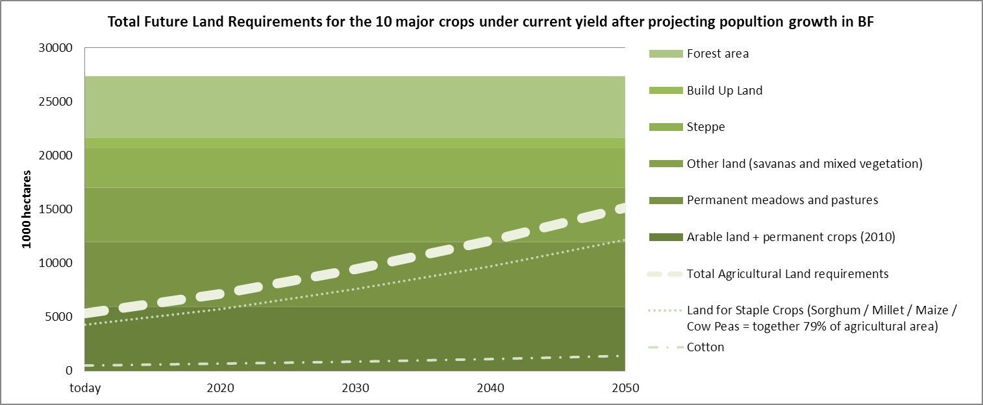
Projected CLEWS-relevant developments - Land use -
The agricultural land-use projection is based on constant yield per hectare assuming official population growth rates. In this scenario, agricultural land on the order of 15 million hectares (half of the land area) would be needed. This amount would cut into the existing pasture land, and would probably also impact forest areas as other suitable land is scarce.

Slide 21
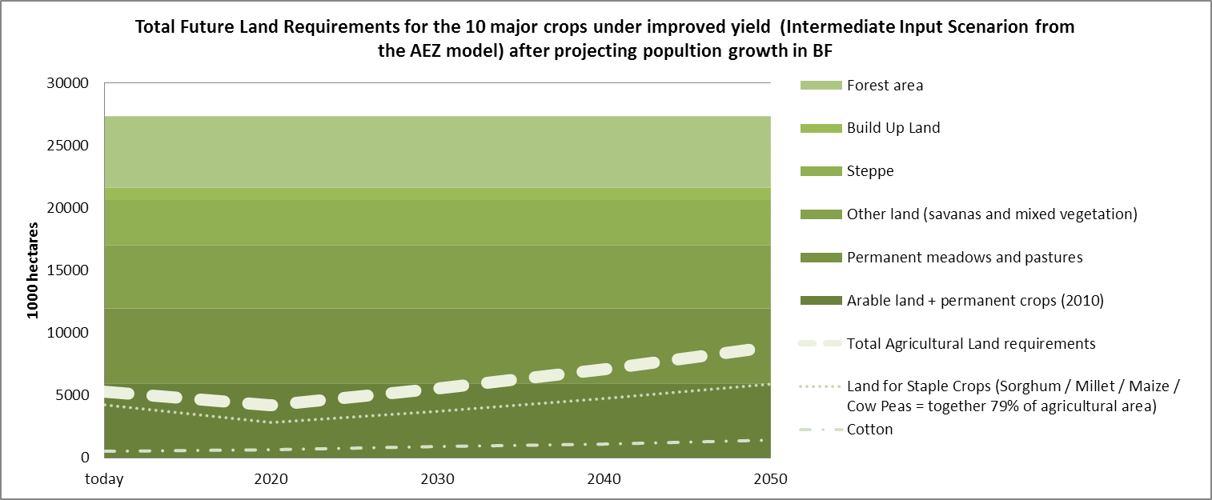
Projected CLEWS-relevant developments - Land use -
The agricultural land-use projection is based on increased yields. In this scenario, energy and water inputs in agriculture are increased to a so-called “intermediate input level”. Intensification of agriculture includes higher mechanization and more fossil fuel inputs, but results in substantially higher yields and therefore a reduced requirement for land.

Slide 22
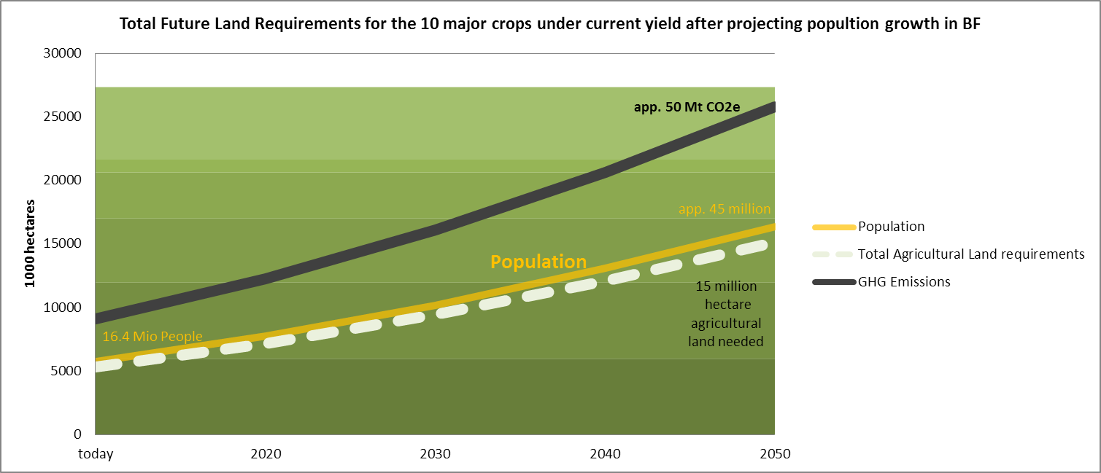
Projected CLEW developments - Land use, energy and greenhouse gas emissions -
Agricultural yields have been decreasing during the past decade. Under current yields, necessary agricultural land area would constantly increase and result in overall growing greenhouse gas emissions. It would extend into more and more unsuitable land and potentially reduce remaining forest area.

Slide 23
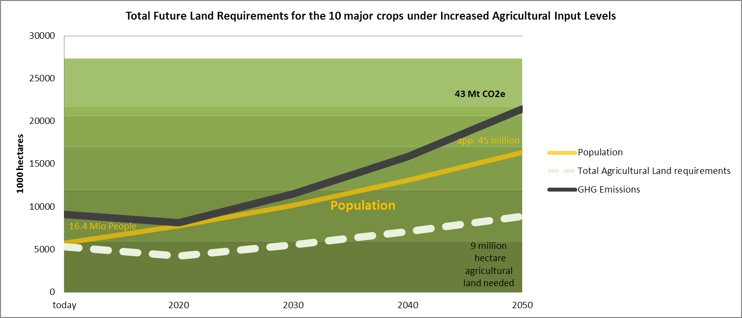
Projected CLEWS-related developments - Land use, energy and greenhouse gas emissions -
With higher inputs, agriculture yields could be increased drastically, resulting in less land required for agriculture, and less loss of forest and savannah. Greenhouse gas emissions produced by the increased amounts of energy needed for this scenario (approximately tenfold compared to today) would be far less than emissions saved through reduced deforestation and overall reduced agricultural area.

Slide 24

New York City
Aim: to quantitatively demonstrate the added value of an integrated CLEWS assessment
How: extend the analysis of water interventions to include energy by using an integrated CLEWS approach
Where: NYC
Why: utilities are managed in relative isolation:
Water efficiency is implemented at a given price payback
Energy efficiency is implemented at a given price payback
Emissions mitigation measures are implemented at a given price payback
So why not take an integrated approach?

Slide 25
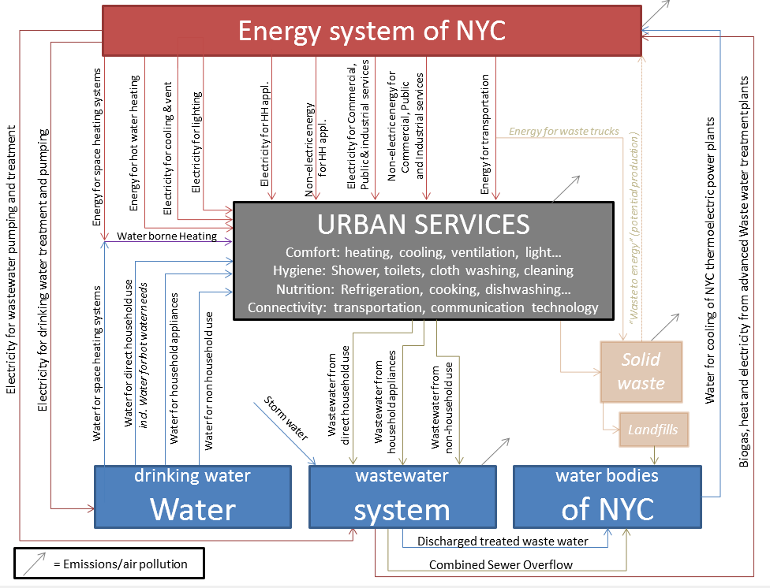
Reference resource diagram

Slide 26
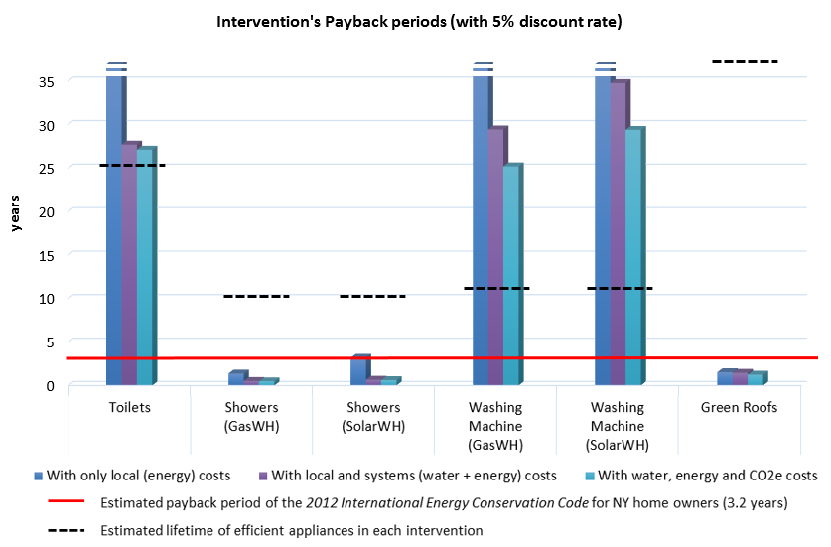
New York City

Slide 27
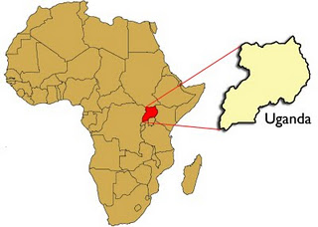
Uganda
Aim: to quantify the resilience of large-scale hydro expansion using a CLEWS assessment
How: by assessing global climate change, regional power expansion and local demands, a CLEWS approach may provide new insights
Where: Uganda
Why: hydro investments needed to meet local water and regional electricity needs
Ethiopia is expanding its hydro system rapidly, potentially affecting Uganda’s hydropower investments and trade potential
Climate change (with associated water withdrawals) may change overall national production potential
Local water requirements, especially for agriculture, are expected to grow

Slide 28
Uganda
Resilience of African energy infrastructure to climate change: Uganda as part of the East African Power Pool
Net electricity imports
Average costs of electricity generation
Notes:
Scenarios are wettest or driest for the region as a whole. Countries are affected differently, which results in variations in electricity trade potential across the region.
In terms of cost, a wet scenario would lower generation costs to a degree for most of the model horizon, but a dry scenario would substantially increase generation costs for the majority of the model horizon. Energy planning needs to account for such vulnerabilities from climate change.

Slide 29
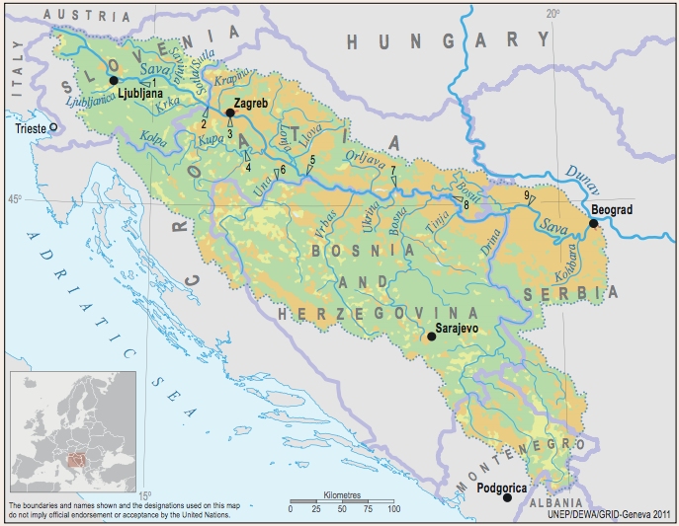
Sava River Basin
Aim: to assess water, energy and agriculture at a subregional level in a transboundary river basin context
Main issues:
Hydropower expansion versus climate change and competing demand from agriculture (irrigation)
Electricity trade and water consumption
Source: United Nations Economic Commission for Europé (2011). Second Assessment of Transboundary Rivers, Lakes and Groundwaters.

Slide 30
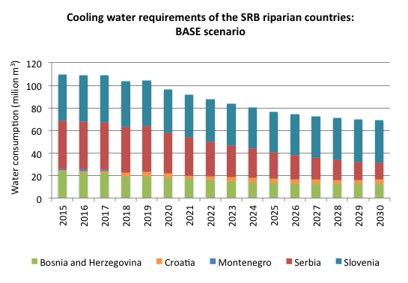
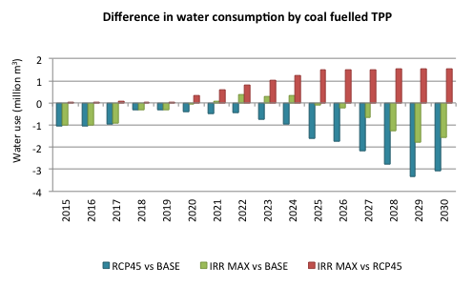
Sava River Basin: water for thermal cooling

Slide 31
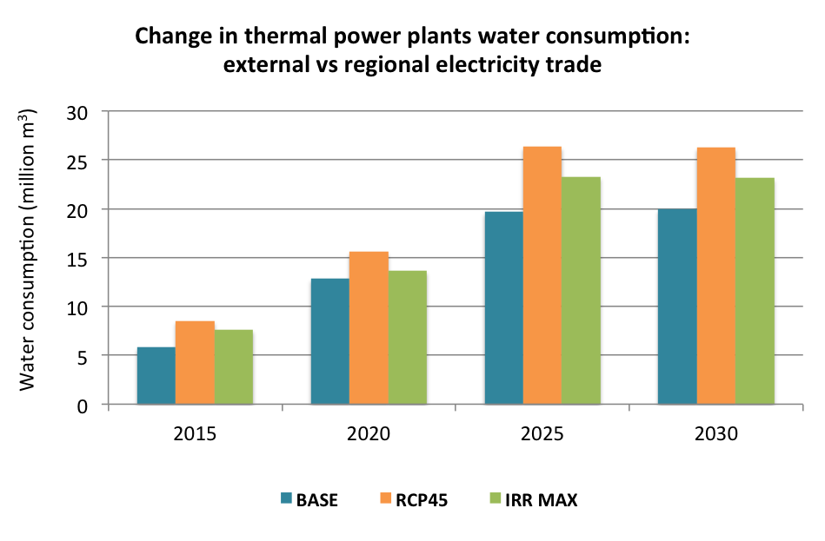
Sava River Basin: cooling requirements and electricity trade
Trade impact on water consumption for cooling from thermal power plants:
Higher levels of exports imply more generation by fossil fuel-based technologies, especially coal, which is a domestic resource (Bosnia and Herzegovina, Serbia and Slovenia).

Slide 32
Closing remarks
CLEWS studies cannot assess all relevant issues:
Quantification and valuation of ecosystem services to assess the impact of cropping practices on the loss of biodiversity
The expansion of agriculture into natural habitats and the adoption of monoculture
May have an impact on biodiversity and ecosystem services, which, in turn, may lead to adverse effects on freshwater resources, soil health and climate variability
CLEWS models help integrated planning at the local and national levels by providing important insights on interlinkages, but cannot foretell the future
Decisions have to be made by governments and business without a full comprehension of all relevant interlinkages and possible consequences; tools are being designed that inform possible options

Slide 33
http://un-desa-modelling.github.io/clews-mauritius-visualisation/dist/

